Slide 1


Premier Presentation

Slide 2

Scanners
By j.j. johnson
Notes:
What type of scanner do you have?
Are you thinking about an upgrade?

Slide 3

DIGITAL PACK RAT
CLIPPINGS
Magazine articles
Purchase receipts
Cooking recipes
Playbills (theater)
Notes:
What type of scanner do you have?
Are you thinking about an upgrade?

Slide 4
DIGITAL PACK RAT
Photos
Slides (60s)
Family
Trip
Military
Notes:
What type of scanner do you have?
Are you thinking about an upgrade?

Slide 5
DIGITAL PACK RAT
Documents
Birth/death certificates
Deeds
Bill of sale
Med records
Taxes
Bills
Manuals
Notes:
What type of scanner do you have?
Are you thinking about an upgrade?

Slide 6

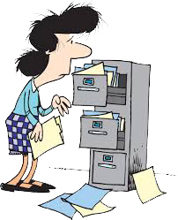
Buried in clutter
HELP!

Slide 7

Scan it!

Slide 8

scanners
Hand Scanners
Flatbed Scanners
Photo Scanners
Document Scanners
All-in-One Printer/Scanners
3D Scanners

Slide 9
Def: Scanners
Is a device that capture images from photographic prints, posters, magazines and similar sources for computer editing and display. Scanners come in hand-held, feed in and flatbed types and for scanning black –and-white only or color
Very high-resolution scanners are used for capturing high-resolution prints, but low-resolution scanners are adequate for capturing image for computer display. Scanners usually come with software, such as Adobe Photoshop product, that let you resize and otherwise modify a capture image.

Slide 10
Hand scanners
A scanner that is moved by the hand over the material being captured.
Notes:
All scanners help digitize memories
Photos, documents

Slide 11
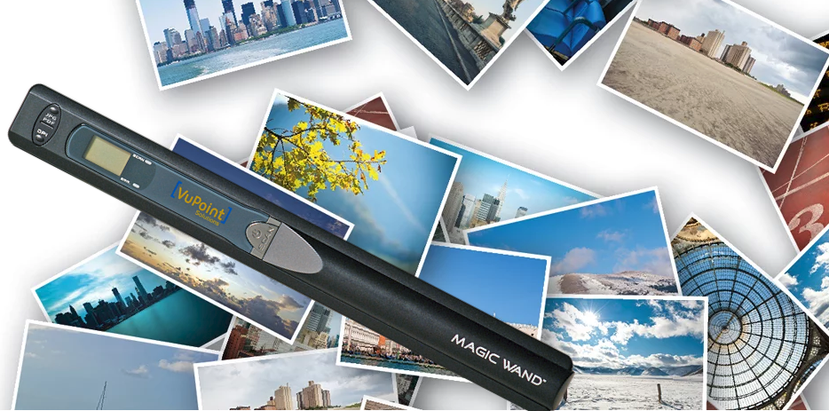
Vupoint magic wand
Portable 2-in-1
Status LCD menu panel
Scan directly to microSD memory card
Rechargeable battery
Notes:
Robin used for Genealogy and talked me into one
Scanning recipes
News articles

Slide 12


Slide 13
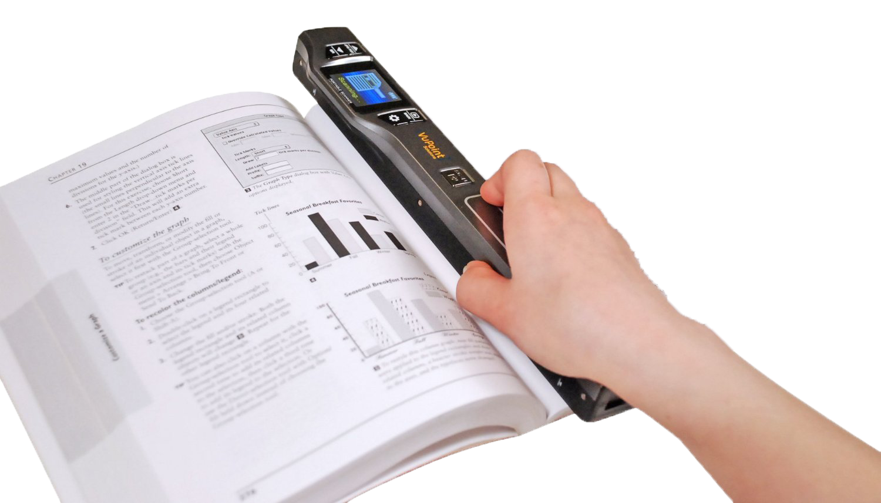
Vupoint magic wand
Books
  Library reserch
Photos
  Family & Friends
Magazines
  Recipes
  Articles
Notes:
Scanning books or magazine without ripping pages

Slide 14
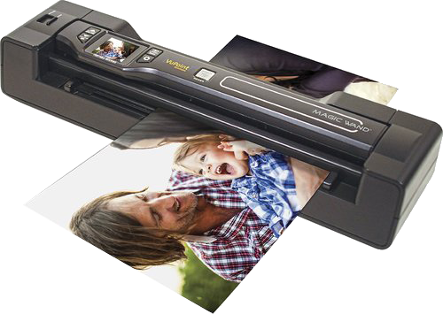
Vupoint magic wand
Books
Photos
Magazines
Notes:
Scanning photos
Family reunions
Visiting relatives memories

Slide 15
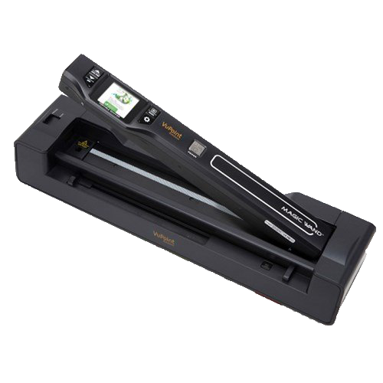
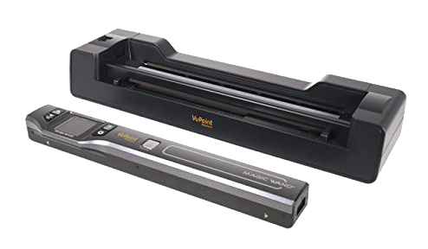
Vupoint magic wand
Docking Station
  Automatic Feed
    Paper
    Photos
Notes:
Sold separate or bungle

Slide 16
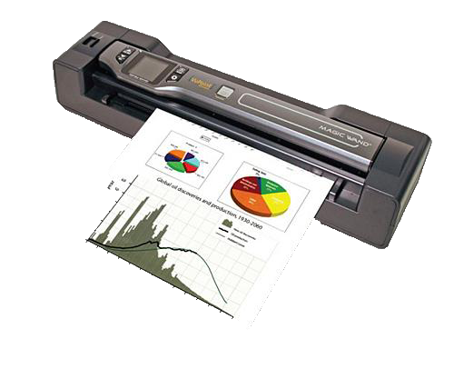
Vupoint magic wand
Docking Station
  Format
    JPEG or PDF
  Resolution
    300, 600, 1200 dpi
  Color
    Color/Mono

Slide 17
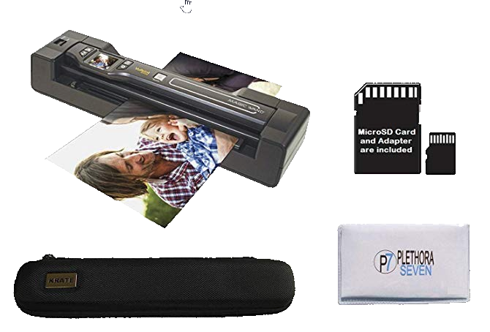
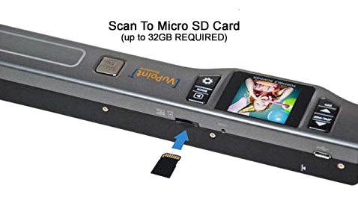
Vupoint magic wand
Accessories
  Micro SD Card
  Docking station
  Carrying Case
  Cleaning Cloth

Slide 18

Desktop camera Scanner

Slide 19
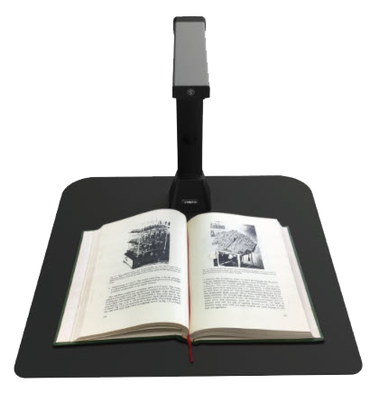
Desktop camera Scanner
IRIScan Desk 5
USB-powered
Scans
  Books
  Documents
  Passport
  Drawings
Notes:
Desk 5 $199
Desk 5 Pro $299

Slide 20
Desktop camera Scanner
Books
3 sec scan
Double page PDF
Auto page detection of page turning

Slide 21
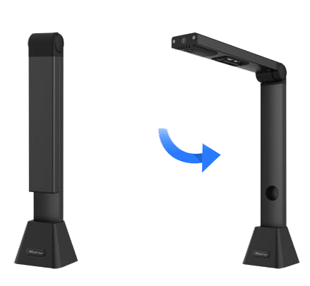
Desktop camera Scanner
OCR Scanning
130 language
Export
  JPT
  PDF
  TXT

Slide 22

Desktop camera Scanner
How to scan a book

Slide 23
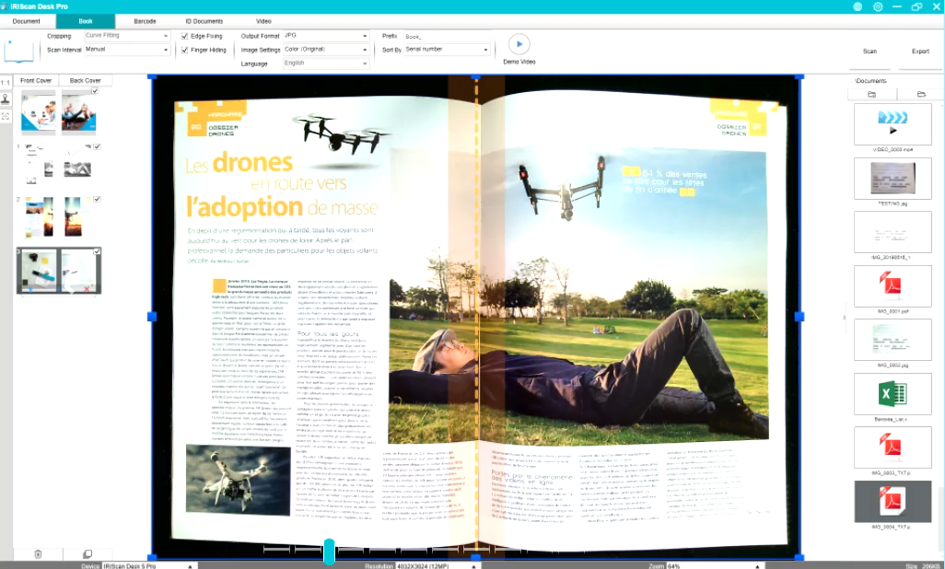
Desktop camera Scanner
Notes:
Export to ePub, PDF or Readis MP3 and WAV audio files to read on readers, tablet or smartphone.

Slide 24
Flatbed scanners
A type of optical scanner designed especially for scanning photographs… A typical photo scanner is a sheet-fed scanner that can scan 3x5 or4x6 photographs as 300 dpi or higher resolution.
Notes:
Can be used for scanning books or magazine
Some odd shape objects
Slip hindge

Slide 25
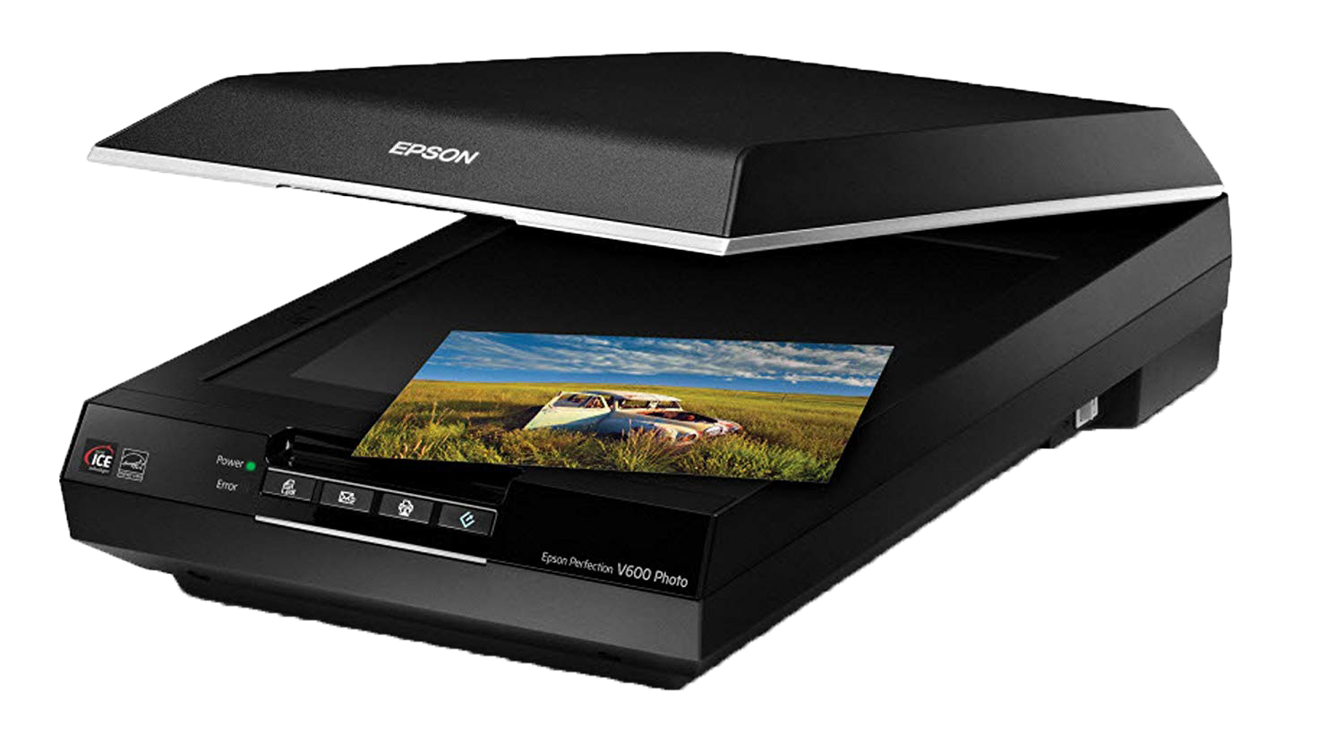
Flatbed scanners
A scanner that provides a flat glass surface to hold a sheet of paper, book or other objects for scanning. The scan head is moved down under the glass.
How Scanners Work
Notes:
Many of you have printer/scanner
YouTube How Scanners Work

Slide 26

Epson perfection v600
Notes:
$199 Amazon

Slide 27
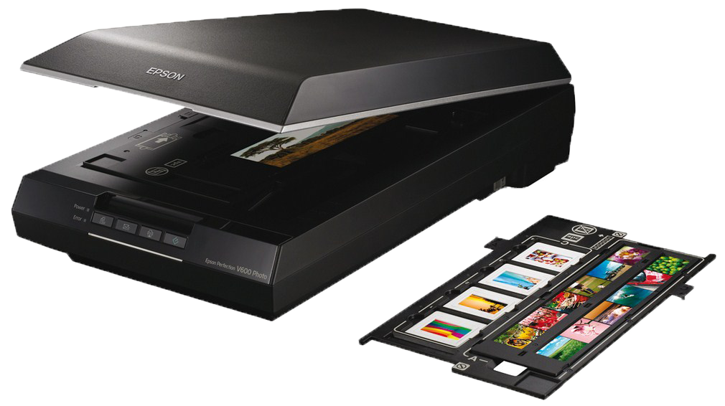
Epson perfection v600
Photo scanning
Slide scanning
Film strip scanning
Notes:
Converted many photos to digital / Moms
Slides from 1964 Olympics Tokyo Japan
Film strips from back in the days
$199 Amazon
6400 x 9600 dpi
17’ x 22”
Digital ICE

Slide 28
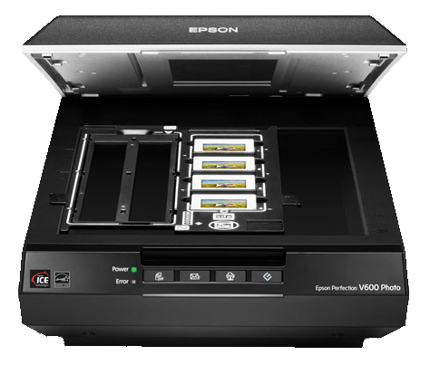
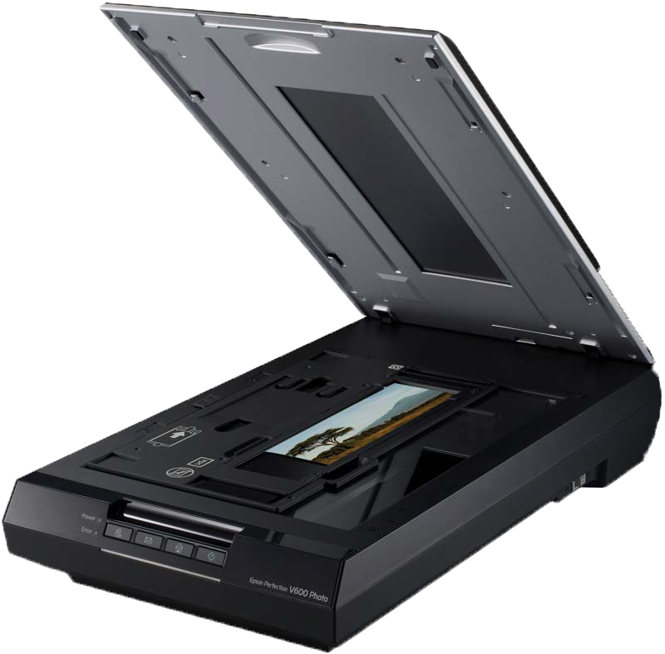
Epson perfection v600
Photo scanning
Slide scanning
Film strip scanning
Notes:
Scans each slide and then saves file
Top light is light box for scanning
Multi photo scanning….to files

Slide 29
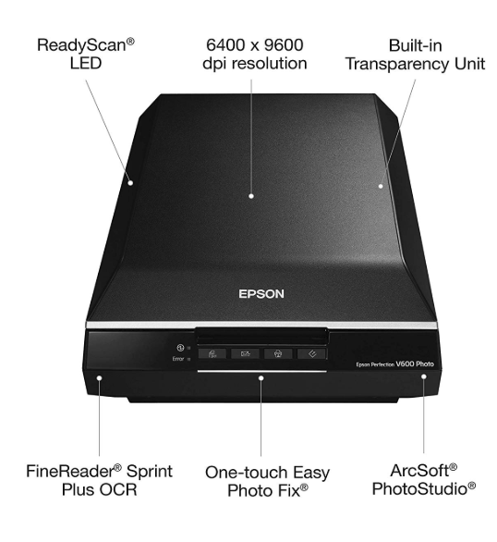
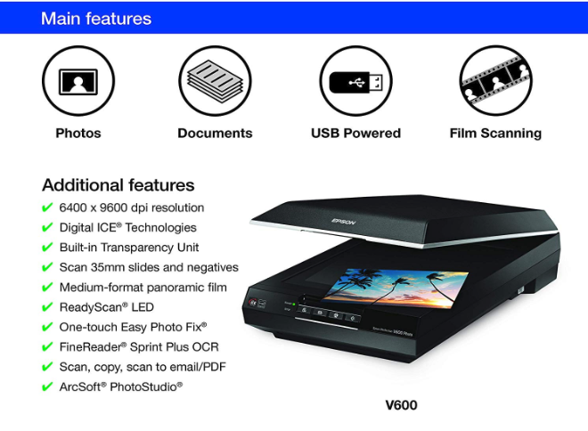
Epson perfection v600
Main features
Controls

Slide 30

Photo scanners
Some photo scanners are especially designed to scan negatives and slides
Notes:
Film strips and slides from the 60s
1964 Olympics in Japan

Slide 31
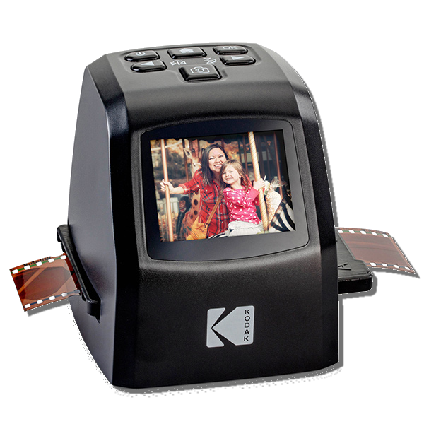
Photo scanner
KODAK Mini Digital Film & Slide Scanner
Film strips: 135, 126, 110
Output: JPEG
Save: USB to computer or SD card
Notes:
$129 Amazon
14/22 MP
Adjustable brightness & color
Continues loading

Slide 32
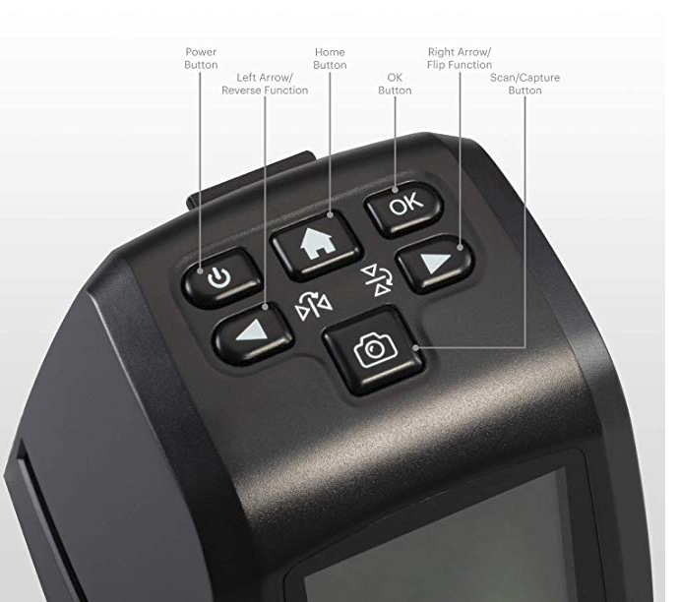
Photo scanner
KODAK Mini Digital Film & Slide Scanner
Film strips: 135, 126, 110
Output: JPEG
Save: USB to computer or SD card
Controls

Slide 33
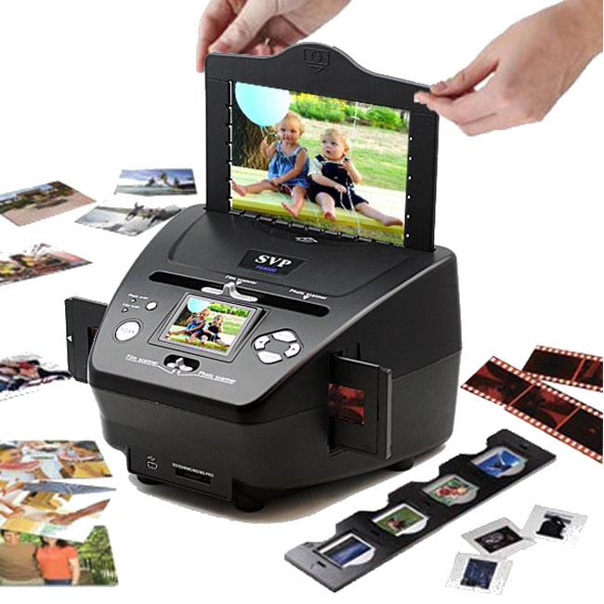
Photo scanners
DIGITNOW
35mm
135 Slide& Negatives
Photos
  3 ½ / 2x5, 4x6, 5x7
Save to SD card or USB transfer
Notes:
$99 Amazon
32 M memory installed
USB transfer to PC

Slide 34

TIME
TO
GO
PAPERLESS
Notes:
Converted my 4-drawer file cabinet

Slide 35
Document scanners
A document scanner is a device that electronically copies content from printed pages and turns it into a computer digital file.
Notes:
Converted my 4-drawer file cabinet

Slide 36

document scanners
Quickly declutter your workspace
Create searchable PDF files
Double-sided scanning
50 sheet document feed
ORC (Optical Character Recognition)
Notes:
Does you desk look like this?
Dedicated to scanning paper

Slide 37

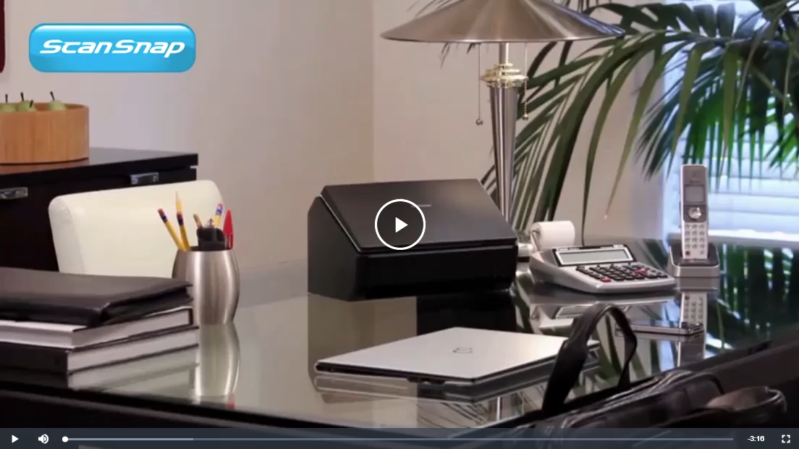
FuJitsu ScanSnap iX500
ScanSnap iX500

Slide 38
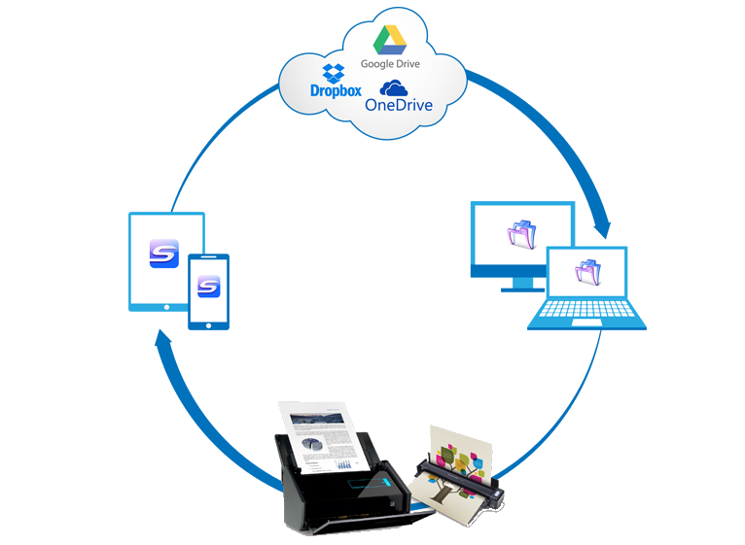
document scanners
Double-sided scanning
50 sheet document feed
Scan to cloud accounts
WiFi scan to smartphone/tablets

Slide 39
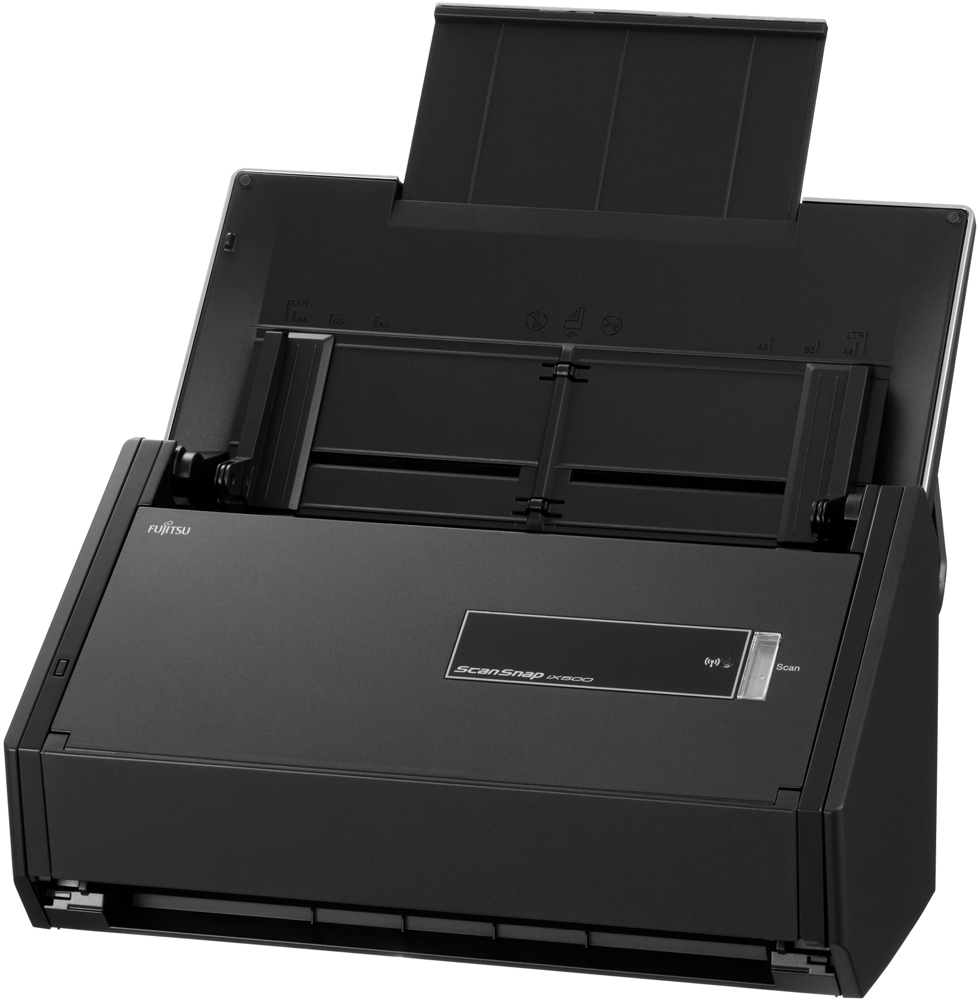
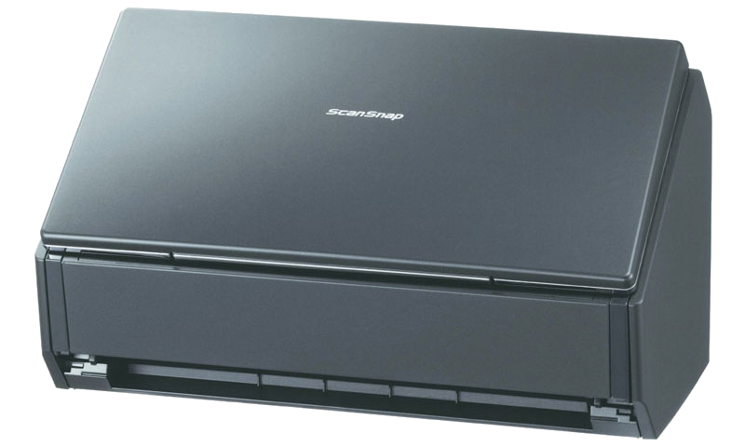
FuJitsu ScanSnap iX500

Slide 40
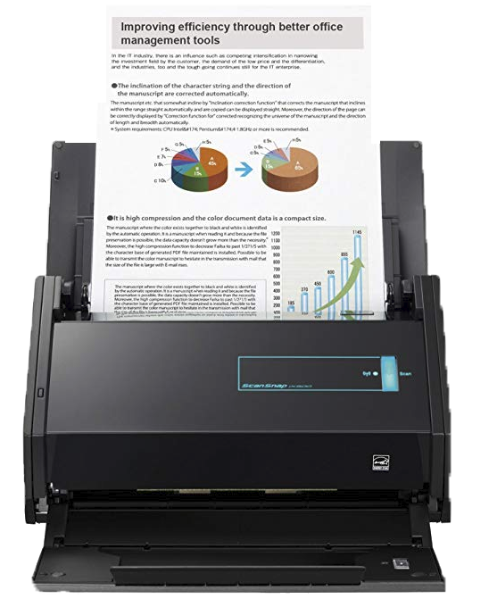
FuJitsu ScanSnap iX500
PDF or JPEG
One touch scanning
Scan wireless to:
  PC, Smartphone or tablet
50 sheet Automatic Document Feed

Slide 41
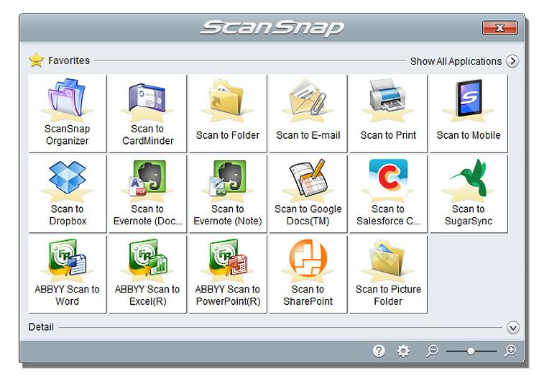
FuJitsu ScanSnap iX500
Applications
  Folders
  CardMinder
  Email
  Mobile
  Dropbox
  Google Docs
  Evernotes

Slide 42
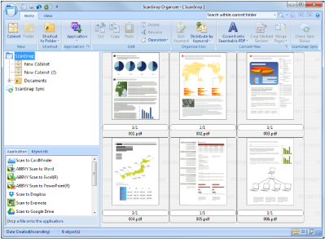
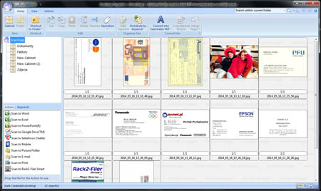
FuJitsu ScanSnap iX500
Organizing
  Filing
    Folders
    Renaming files/folders
  Viewing
  Searching
  Printing
  Emailing
Notes:
Files:
Bills
Med & Health records
Important STUFF

Slide 43
2-in-1 scanner printers
A MFPs multi-functional all-in-one devices generally include a scanner, printer and fax. They are capable of scanning photos, documents and printing or saving to a computer or flash drive.
Notes:
HP, Canon, Epson
Newer with WiFi printing
Photo printing not the best
MFD

Slide 44
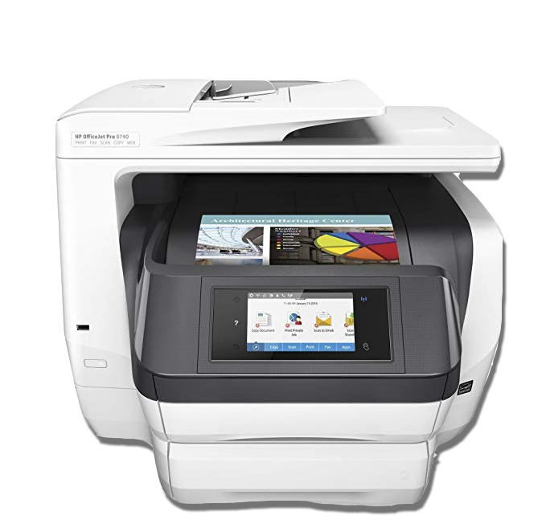
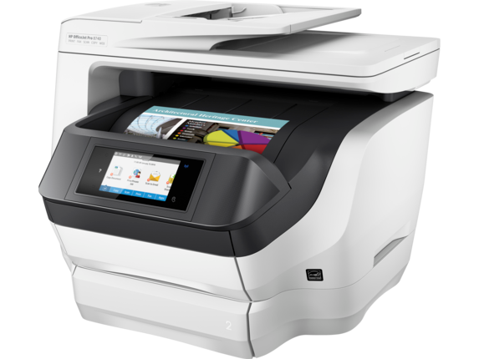
HP Officejet 8740
Copy, Print, Scan, Fax
Wireless Printing
Two-sided duplex printing
  500 sheet paper capacity
Scanning
  2-sided
  Scan to USB drive/network drive
Color touchscreen
2 paper trays
Auto document feed
Scan to USB
Notes:
$299 Amazon
Works with Alexa
Fax???
Print from smartphone and tablet
2-sided print, copy, scan
Borderless printing
NFC touch-to-print
USB port for Flash Drive

Slide 45
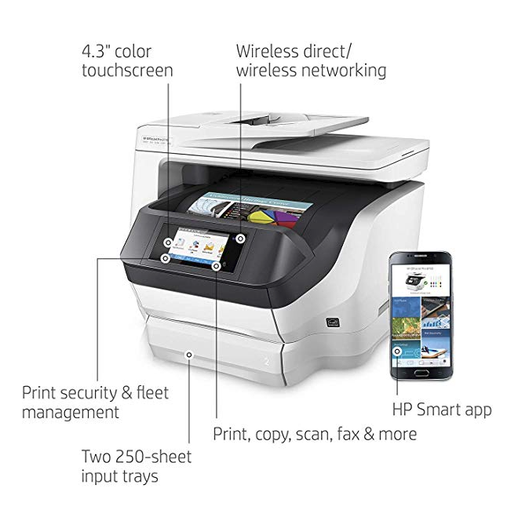
HP Officejet 8740
Copy, Print, Scan, Fax
Wireless Printing
Two-sided duplex printing
  500 sheet paper capacity
Color touchscreen
2 paper trays
Auto document feed

Slide 46
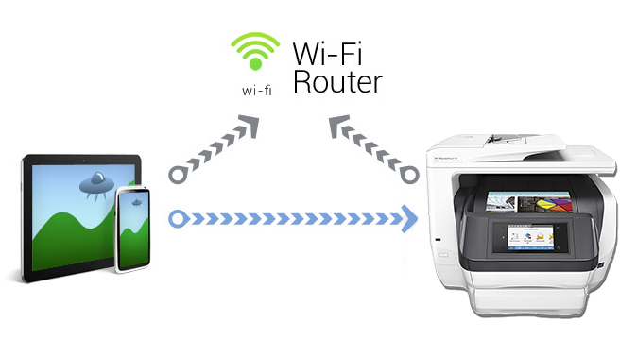
Mobile printing
App
  Smartphone
  Tablet
Notes:
HP smart app mobile wireless printing

Slide 47
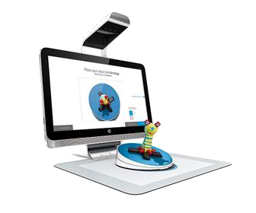
3d scanners

Slide 48

Hp sprout
Notes:
$747 Amazon
$3375 Pro G2

Slide 49

Hp sprout
All-in-one PC desktop
Dual-touchscreen PC
3D scanner/document scanner
Touch mat/scanner bed

Slide 50
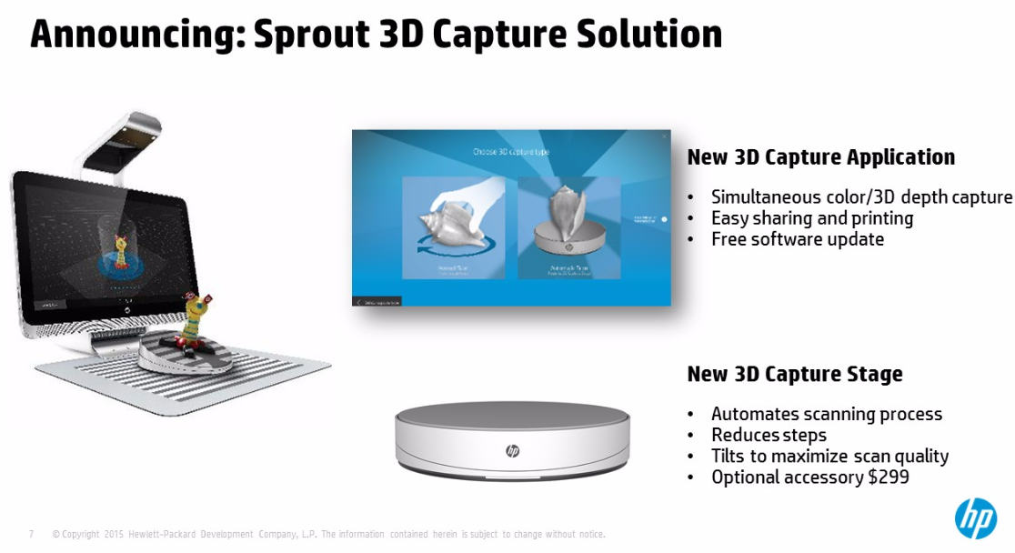

Slide 51
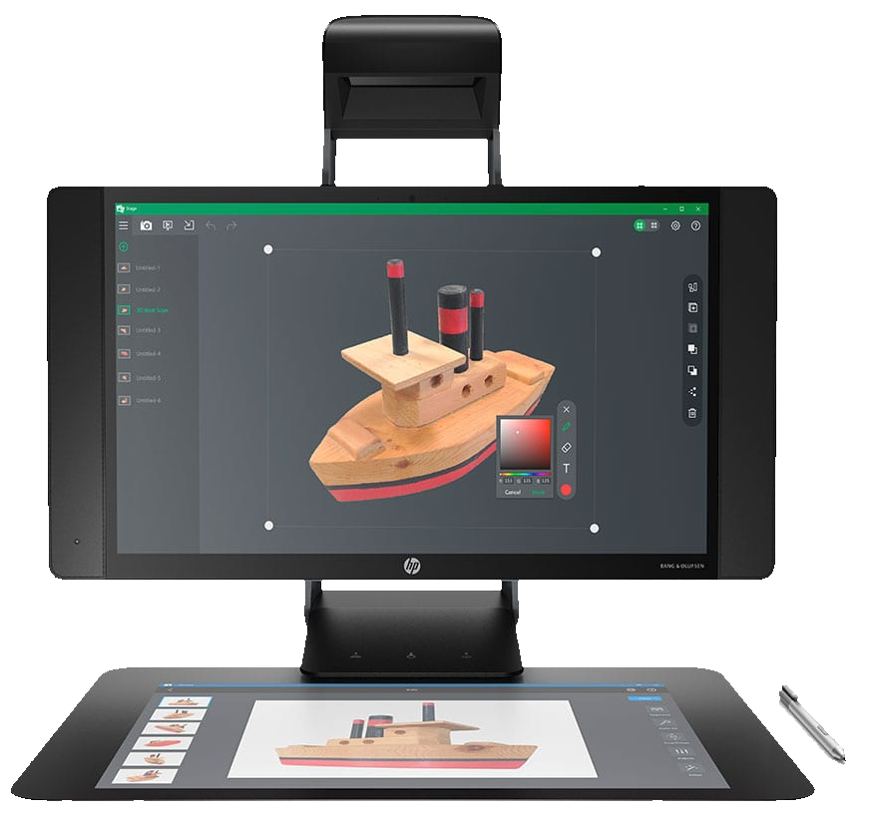
HP Sprout Pro g2
23.8” Multi-Touch
2.9 GHz Intel i7-7700T Quad-Core
32GB RAM
GPU – NVIDA GeForce GTX M
Notes:
23.8 Pro G2 $3,375.00
Res: 1920x1080
512GB
28” Studio $3,499.00
4500x3000
1TB

Slide 52
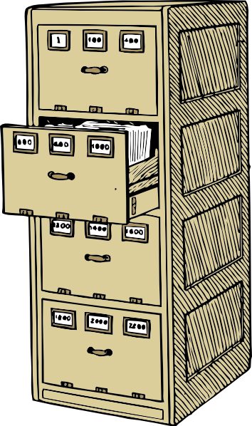
Organize
Documents
  Birth certificates
  Deeds
Photos
  Family
  Travel
Finance
  Bills
  Taxes
Home
  Insurance
  Repairs
Notes:
You computer is your file cabinet

Slide 53
Resources
Fujitsu
  SnapScan iX500
VuPoint Soutions
  Magic Wand Portable
IRIScan Desk 5
Epson
  V600
HP
  HP OfficeJet Pro 8740
  Sprout
Scan it!

Slide 54


Slide 55


Any questions

Slide 56


